Slide 1
Module 4- Software Design Specification
Effective modular design –Cohesion and coupling
Cohesion and Coupling

Slide 2
Desired Class/Object/Module Interaction
Maximize internal interaction (cohesion)
  easier to understand
  easier to test
Minimize external interaction (coupling)
  can be used independently
  easier to test
  easier to replace
  easier to understand

Slide 3
Characteristics of Good Design
Component independence
  High cohesion
  Low coupling
Exception identification and handling
Fault prevention and fault tolerance

Slide 4
Cohesion
A cohesive module performs a single task within a software procedure requiring little interaction with procedures being performed in other parts of a program
Definition
  The degree to which all elements of a component are directed towards a single task
  The degree to which all elements directed towards a task are contained in a single component
  The degree to which all responsibilities of a single class are related
Internal glue with which component is constructed
All elements of a component are directed toward and essential for performing the same task
High is good

Slide 5
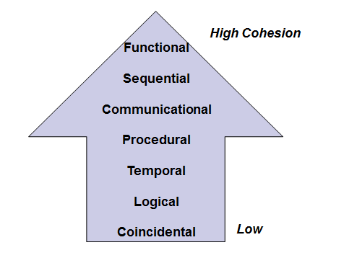
Types of Cohesion

Slide 6
Coincidental cohesion
It is unplanned and random cohesion, which might be the result of breaking the program into smaller modules for the sake of modularization. Because it is unplanned, it may serve confusion to the programmers and is generally not-accepted.
No reusability
Difficult corrective maintenance or enhancement
Elements needed to achieve some functionality are scattered throughout the system.
Accidental Worst form
Example : an "Utilities" class

Slide 7
Coincidental Cohesion - example
/*
Joe's Stuff
*/
class Joe {
public:
// converts a path in windows to one in linux
string win2lin(string);
// number of days since the beginning of time
int days(string);
// outputs a financial report
void outputreport(financedata, std::ostream&);
};

Slide 8
Example
Print next line
Reverse string of characters in second argument
Add 7 to 5th argument
Convert 4th argument to float
Notes:
I don’t even want to think about it.

Slide 9
Logical cohesion
When logically categorized elements are put together into a module, it is called logical cohesion.
Several logically related elements are in the same component and one of the elements is selected by the caller.
May include both high and low-level actions in the same class
May include unused parameters for certain uses
Interface is difficult to understand
In order to do something you have to wade through a lot of unrelated possible actions
Example: grouping all mouse and keyboard input handling routines

Slide 10
Logical Cohesion
class Output {
public:
// outputs a financial report
void outputreport(financedata);
// outputs the current weather
void outputweather(weatherdata);
// output a number in a nice formatted way
void outputint(int);
};

Slide 11
Example
A component reads inputs from tape, disk, and network. All the code for these functions are in the same component. Operations are related, but the functions are significantly different.
Improvement
A device component has a read operation that is overridden by sub-class components. The tape sub-class reads from tape. The disk sub-class reads from disk. The network sub-class reads from the network.
Notes:
I don’t even want to think about it.

Slide 12
Temporal Cohesion
When elements of module are organized such that they are processed at a similar point in time, it is called temporal cohesion.
Elements of a component are related by timing.
Difficult to change because you may have to look at numerous components when a change in a data structure is made.
Increases chances of regression fault
Component unlikely to be reusable.
Often happens in initialization or shutdown
Example: a function which is called after catching an exception which closes open files, creates an error log, and notifies the user

Slide 13
Temporal Cohesion – Example
class Init {
public:
// initializes financial report
void initreport(financedata);
// initializes current weather
void initweather(weatherdata);
// initializes master count
void initcount();
}

Slide 14
Example
A system initialization routine: this routine contains all of the code for initializing all of the parts of the system. Lots of different activities occur, all at init time.
Improvement
A system initialization routine sends an initialization message to each component.
Each component initializes itself at component instantiation time.
Notes:
I don’t even want to think about it.

Slide 15
Procedural Cohesion
When elements of module are grouped together, which are executed sequentially in order to perform a task, it is called procedural cohesion.
Definition: Elements of a component are related only to ensure a particular order of execution.
Actions are still weakly connected and unlikely to be reusable
Changes to the ordering of steps or purpose of steps requires changing the module abstraction
Example: a function which checks file permissions and then opens the file

Slide 16
Procedural Cohesion – Example
class Data {
public:
// read part number from an input file and update
// the directory count
void readandupdate (data&);
};

Slide 17
Example
...
Read part number from data base
update repair record on maintenance file.
...
May be useful to abstract the intent of this sequence. Make the data base and repair record components handle reading and updating. Make component that handles more abstract operation.

Slide 18
Communicational Cohesion
When elements of module are grouped together, which are executed sequentially and work on same data (information), it is called communicational cohesion.
Definition: Module performs a series of actions related by a sequence of steps to be followed by the product and all actions are performed on the same data
Action based on the ordering of steps on all the same data
Actions are related but still not completely separated
Module cannot be reused

Slide 19
Communicational Cohesion
class Data {
public:
// update record in database and write it to
// the audit trail
void updateandaudit (data);
};
class Trajectory {
// calculate new trajectory and send it to the printer
void newtrajectoryandprint();
};

Slide 20
Example
Update record in data base and send it to the printer.
database.Update (record).
record.Print().
Notes:
I don’t even want to think about it.

Slide 21
Sequential Cohesion
When elements of a module are grouped because the output of one element serves as input to another and so on, it is called sequential cohesion.
Methods are together in a class because the output from one part is the input to another part like an assembly line
The output of one component is the input to another.
Occurs naturally in functional programming languages
Good situation
Example: a function which reads data from a file and processes the data

Slide 22
Functional Cohesion
It is considered to be the highest degree of cohesion. Elements of module in functional cohesion are grouped because they all contribute to a single well-defined function.
Definition: Every essential element to a single computation is contained in the component.
Every element in the component is essential to the computation.
Ideal situation.
Example: tokenizing a string of XML

Slide 23
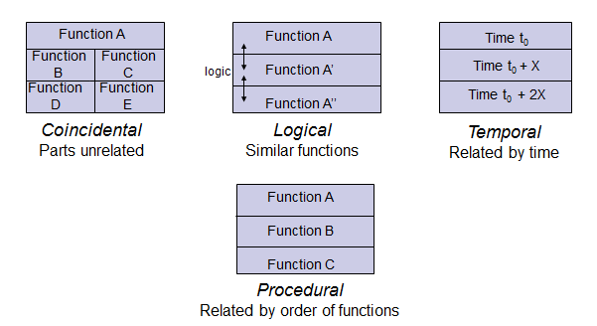
Examples of Cohesion

Slide 24
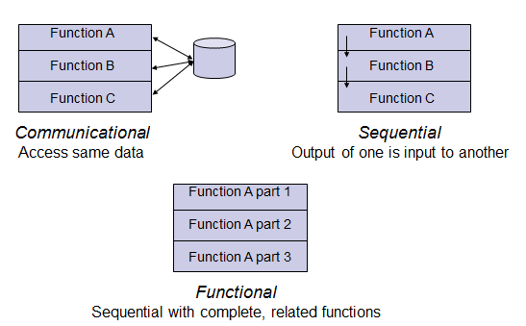
Examples of Cohesion

Slide 25
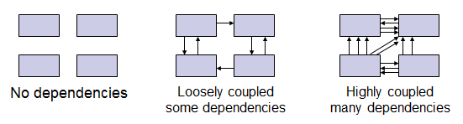
Coupling
The degree of dependence such as the amount of interactions among components

Slide 26
Coupling: Degree of dependence among components
No dependencies
Loosely coupled-some dependencies
High coupling makes modifying parts of the system difficult, e.g., modifying a component affects all the components to which the component is connected.
Highly coupled-many dependencies

Slide 27
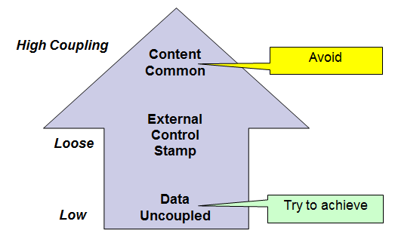
Types of Coupling

Slide 28
Content Coupling
When a module can directly access or modify or refer to the content of another module, it is called content level coupling.
Definition: A module directly references the content of another module
  module p modifies a statement of module q
  Module p refers to local data of module q (in terms of a numerical displacement)
  Module p branches to a local label of module q
  Change to module p requires a change to module q (including recompilation)
  Reusing module p requires using module q also
Typically only possible in assembly languages

Slide 29
Example of Content Coupling
Part of program handles lookup for customer.
When customer not found, component adds customer by directly modifying the contents of the data structure containing customer data.
Improvement:
When customer not found, component calls the AddCustomer() method that is responsible for maintaining customer data.

Slide 30
Common Coupling
When multiple modules have read and write access to some global data, it is called common or global coupling.
Using global variables (i.e., global coupling)
All modules have read/write access to a global data block
Modules exchange data using the global data block (instead of arguments)
Single module with write access where all other modules have read access is not common coupling

Slide 31
Common Coupling (cont)
Have to look at many modules to determine the current state of a variable
Side effects require looking at all the code in a function to see if there are any global effects
Changes in one module to the declaration requires changes in all other modules
Identical list of global variables must be declared for module to be reused
Module is exposed to more data than is needed

Slide 32
Common Coupling Continue…
Usually a poor design choice because
  Lack of clear responsibility for the data
  Reduces readability
  Difficult to determine all the components that affect a data element (reduces maintainability)
  Difficult to reuse components
  Reduces ability to control data accesses
Notes:
Pp220+ pfleeger

Slide 33
Example
Process control component maintains current data about state of operation. Gets data from multiple sources. Supplies data to multiple sinks.
Each source process writes directly to global data store. Each sink process reads directly from global data store.
Improvement
Data manager component is responsible for data in data store. Processes send data to and request data from data manager.

Slide 34
Control Coupling
Two modules are called control-coupled if one of them decides the function of the other module or changes its flow of execution.
Definition: Component passes control parameters to coupled components.
May be either good or bad, depending on situation.
  Bad when component must be aware of internal structure and logic of another module
  Good if parameters allow factoring and reuse of functionality

Slide 35
Example
Acceptable: Module p calls module q and q returns a flag that indicates an error (if any)
Not Acceptable: Module p calls module q and q returns a flag back to p that says it must output the error “I goofed up”
Notes:
In right hand side, the sort code is unchanged.

Slide 36
Stamp Coupling
When multiple modules share common data structure and work on different part of it, it is called stamp coupling.
Definition: Component passes a data structure to another component that does not have access to the entire structure.
Requires second component to know how to manipulate the data structure (e.g., needs to know about implementation)
May be necessary due to efficiency factors: this is a choice made by insightful designer.

Slide 37
Example
Customer billing system
The print routine of the customer billing accepts a customer data structure as an argument, parses it, and prints the name, address, and billing information.
  double printEmployee(Employee& e);
  Better
  double printEmployee(
  String Name,
  String Address,
  float illAmount);

Slide 38
Data Coupling
Data coupling is when two modules interact with each other by means of passing data (as parameter).
Definition: Two components are data coupled if there are homogeneous data items.
Every argument is simple argument or data structure in which all elements are used
Good, if it can be achieved.
Easy to write contracts for this and modify component independently.

Slide 39
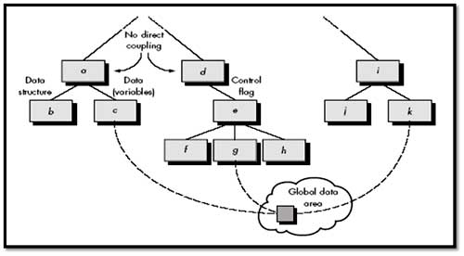

Slide 40
Consequences of Coupling
High coupling
  Components are difficult to understand in isolation
  Changes in component ripple to others
  Components are difficult to reuse
  Need to include all coupled components
  Difficult to understand
Low coupling
  May incur performance cost
  Generally faster to build systems with low coupling

Slide 41
Difference between cohesion and coupling
Cohesion | Coupling
Cohesion is the indication of the relationship within a module. | Coupling is the indication of the relationship with the different module .
Cohesion shows the module’s relative functional strength. | Coupling shows the relative independence among the modules
While designing you should strive for high cohesion i.e. a cohesive component/ module focus on a single task (i.e., single-mindedness) with little interaction with other modules of the system. | While designing you should strive for low coupling i.e. dependency between modules should be less.
Cohesion is the kind of natural extension of data hiding. For example, class having all members visible with a package having default visibility. | Making private fields, private methods and non public classes provides loose coupling
Cohesion is Intra – Module Concept. | Coupling is Inter -Module Concept

Slide 42
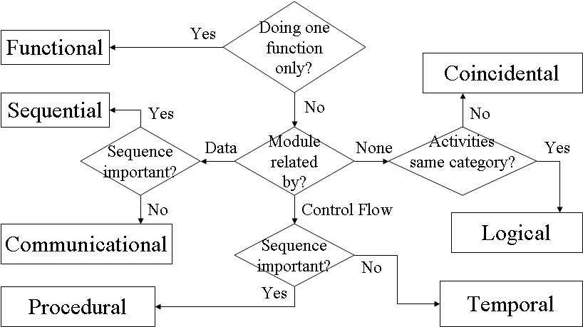

Slide 43

a) Explain Coupling and Cohesion? Explain the types of couplings with example

